Slide 1
Grade 5
1

Slide 2
LISTEN AND SING

Slide 4
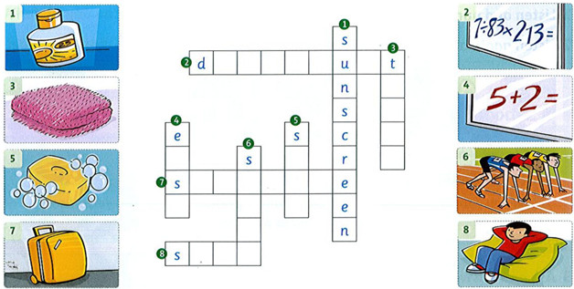
Complete the crossword

Slide 5
Complete the crossword
f
f
i
c
i
l
o
w
e
a
o
l
c
s
u
i
t
a
y
a
p
r
o
f
t

Slide 6
Write: toothbrush, sunscreen, towel, shampoo, toothpaste, suitcase.
Holly is going to go to Florida on vacation. She's putting all her things in her 1suicase. She's going to take her 2_____ to use after swimming. She's going to take her 3­­­________ and 4_______ to brush her teeth. She's going to take some 5______ to wash her hair. She's going to take some 6_______because the sun is very hot in Florida.
towel
toothbrush
toothpaste
shampoo
sunscreen

Slide 7
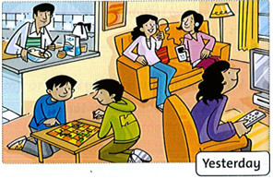
Look and read. Circle.
1. Mom listened / didn't listen to
music yesterday.
2. The girls played / didn't play a game.
3. Dad cooked / didn't cook dinner.
4. The boys played / didn't play a game.
5. Mom watched / didn't watch TV.
6. The girls listened / didn't listen to music.

Slide 8
Write. Use simple present and present progressive. travel / walk eat / go go to bed / play get up / read
travel
am walking
eat
go to bed
am playing
am going

Slide 9
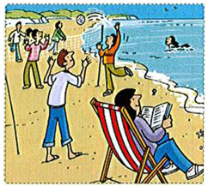
Write: 'm ‘s 're
My family and I are very happy. We ^{1'}regoing to visit our cousins
next week. Our cousins live near the beach, so they²_____going
to take us to the beach every day. I³______ going to swim in the
ocean. My brother doesn't like swimming. He⁴_____ going to play volleyball on the beach. Mom is happy because she ⁵_____going to read her new book. We ⁶______ going to have a great vacation.
‘re
‘m
‘s
‘s
‘re

Slide 10
Write the words under the correct sounds
blue light bike coat sky nose room flute blow
Long i Bike | Long o | Long u

Slide 11
Write the words under the correct sounds
blue light bike coat sky nose room flute blow
Long i Bike Light Sky | Long o Coat Nose blow | Long u Blue Room flute

Slide 12
Read and complete the word. ue u_e oo a_e ea oo
tune
rooms
blue.
cake
leaves.

Slide 13
suitcase
shampoo
toothpaste
toothbrush
soap

Slide 14
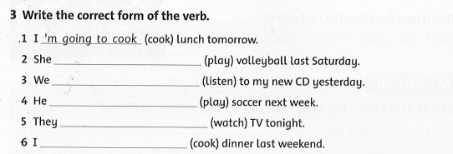
‘s going to play
‘re going to listen
‘s going to play
‘re going to watch
‘m going to cook

Slide 15
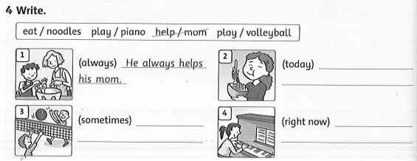
She’s eating noodles today.
She’s playing the piano right now.
They sometimes play volleyball.

Slide 16
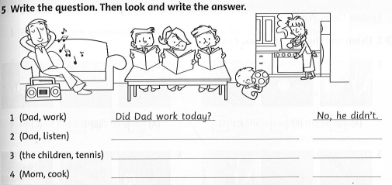
Did Dad listen to the radio?
Yes, he did.
Did the children play tennis?
No, they didn’t.
Did Mom cook?
Yes, she did.

Slide 17
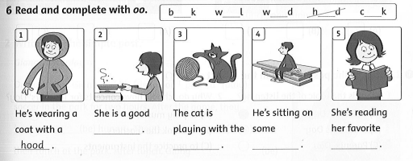
cook
wool
wood
book

Slide 18
GAME TIME

Slide 19
GRAMMAR PLANE
START

Slide 20
Read and fill in the gap!
I sometimes ________ (drink) tea at night
PLANE
I sometimes drink tea at night
CHECK

Slide 21
Read and fill in the gap!
My sister ______ (do) homework now
PLANE
My sister is doing homework now
CHECK

Slide 22
Read and fill in the gap!
The children ________ (draw) now
PLANE
The children are drawing now
CHECK

Slide 23
Read and fill in the gap!
We usually _____ (drink) coffee for breakfast
PLANE
We usually drink coffee for breakfast
CHECK

Slide 24
Read and fill in the gap!
My father ____ (drive) a car now
PLANE
My father is driving a car now
CHECK

Slide 25
Read and fill in the gap!
Our teacher always ___ (eat) soup for lunch
PLANE
Our teacher always eats soup for lunch
CHECK

Slide 26
Read and fill in the gap!
Penguins never ____ (fly)
PLANE
Penguins never fly
CHECK

Slide 27
Read and fill in the gap!
My cat always ____ (sleep) on the sofa
PLANE
My cat always sleeps on the sofa
CHECK

Slide 28
Read and fill in the gap!
I ____ (listen) to the teacher now
PLANE
I am listening to the teacher now
CHECK

Slide 29
Read and fill in the gap!
Boys ____ (play) football now
PLANE
Boys are playing football now
CHECK

Slide 30
Good job!

Slide 31
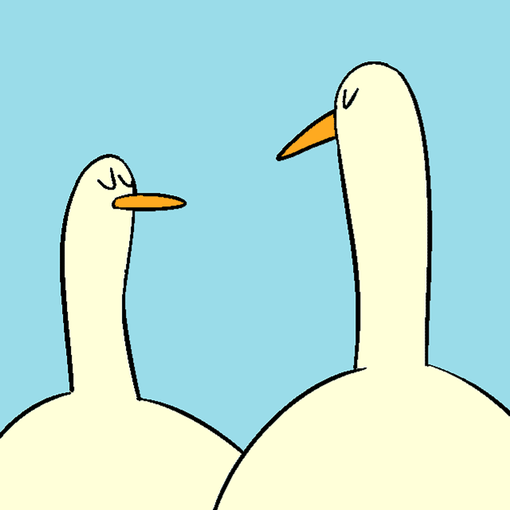
GOODBYE!!!

